Slide 1
Lab work 2
Muhammad Mujtaba SP22-BSE-036

Slide 2
Games
Warcraft II
Diablo
System Shock
Hardware
Software
System Software
Application Software
Notes:
This is a note, part of Activity 9.

Slide 3
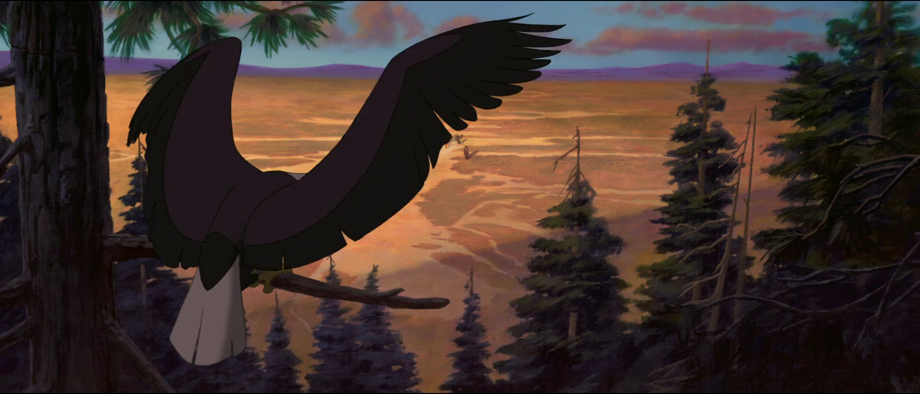
This is a text box!!!

Slide 4
This is a hyperlink!

